Slide 1
Iteration 3
Jonathan Tran, Kazuki Susuki, Jeampy Kalambayi

Slide 2
Team Members
Jonathan Tran
Project Manager & Data Analyzer
Kazuki Susuki
Client Liaison & Visualizer
Jeampy Kalambayi
Data Modeler & Documentation

Slide 3
Kaggle Natural Language Processing Challenge
Client: Prof. Gunay
Goal: Submit to the Kaggle Leaderboard
BERT(Bidirectional Encoder Representation Transformers)
Support Vector Machine
Principle Component Analysis

Slide 4
BERT
Changes made to the model:
Added data cleaning for stopwords, special characters, HTML tags, URLs
Parameter changes
Reduced batch size(more accurate, longer training)
Increased max length of tokens

Slide 5
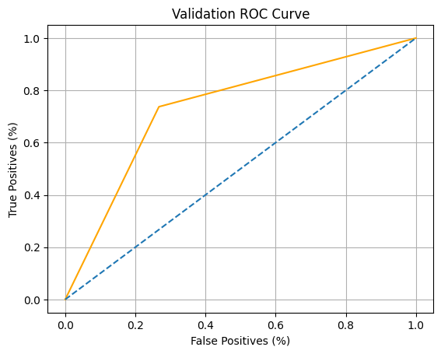
bert
Features:
Submission creation for Kaggle
Tweet classifier demo
ROC Curve
BERT Model

Slide 6
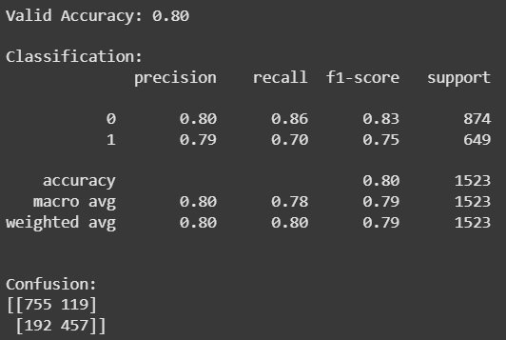
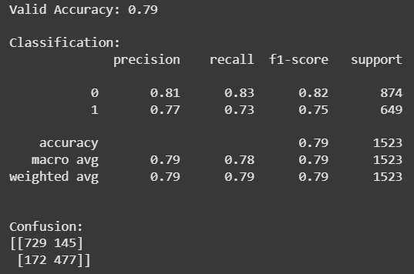
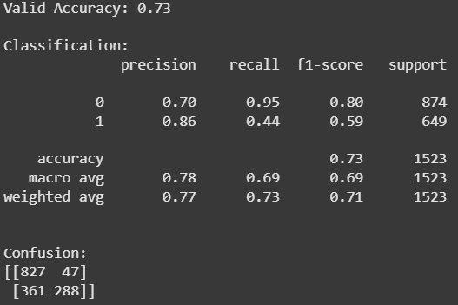
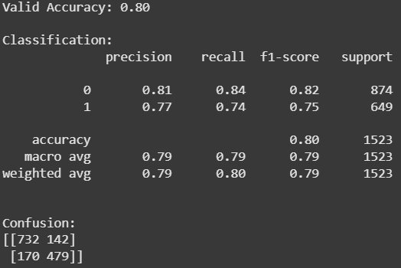
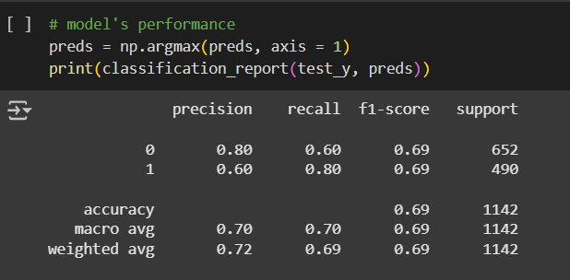
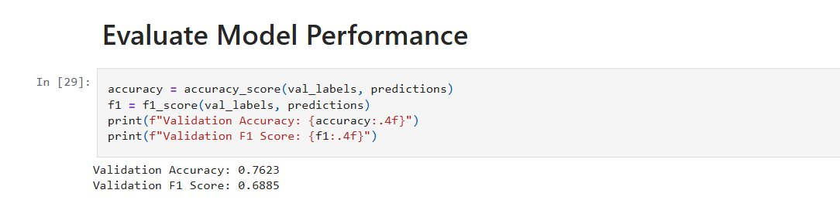
Previous scores

Slide 7
Leaderboard Scoring
SVM
BERT
PCA

Slide 8
Performance overview
Sprint 1:
Data gathering
Data cleaning
Sprint 2:
Model research
Model implementation
Sprint 3:
Website
Model optimization
Visualizations

Slide 9
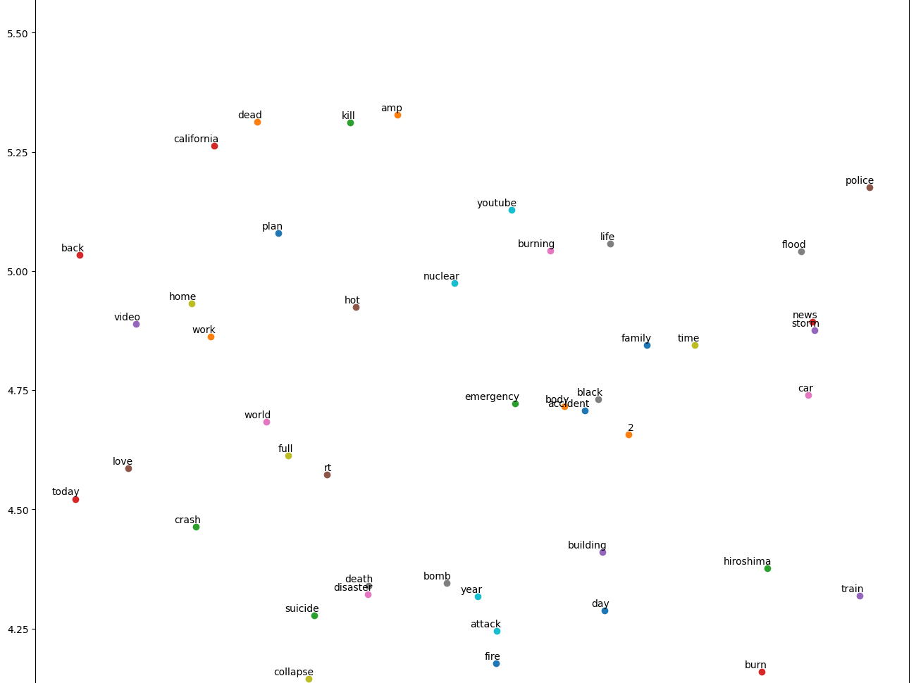
Future implementations
TSNE Graph (disaster/non-disaster)
ROC Curve fix-up
Further optimization (BERT)

Slide 10
website

